Slide 1


Slide 2
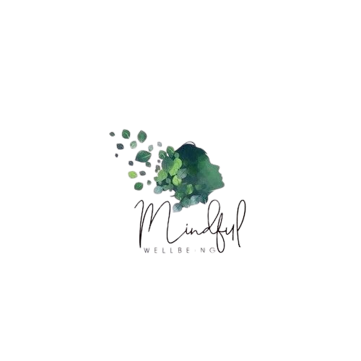

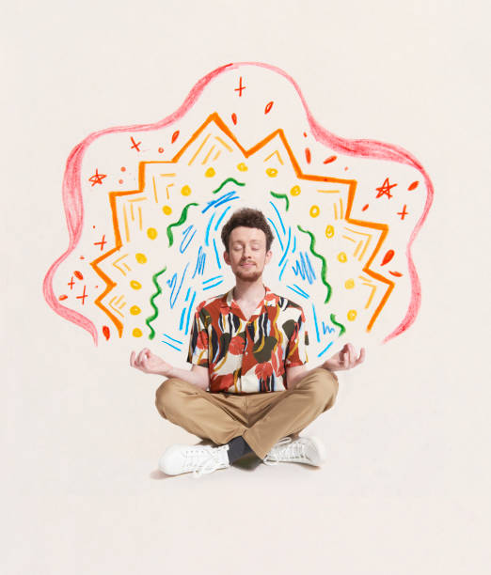
Graduation Project
-
MindFul
-
Presentation 2025
MindFul
Website
Supervised by
Dr. Rodaina Abdelsalam
Eng. Martina Girgis

Slide 3

Abstract
MindFul addresses the critical need for accessible and destigmatized mental health support, particularly in Egypt. With approximately 1 in 8 people globally experiencing mental health disorders, this platform aims to bridge the gap in mental health care by providing comprehensive resources and fostering a supportive community. It leverages AI-powered psychological tests, an AI-driven chatbot using Retrieval-Augmented Generation (RAG) with the Mixtral-8x7B-Instruct-v0.1 model, a section for sharing personal stories, and a directory of licensed mental health professionals. The platform is built with React, HTML, CSS, JavaScript for the frontend, and Node.js, Express.js, and MongoDB for the backend.

Slide 4

Content
Related Work
Proplem
02.
Problem
Solution
01.
02.
03.
Demo Video
Feature Works
Technology/AI
06.
05.
04.
References
Future Work
Conclusion
02.
Problem
08.
08.
09.

Slide 5


Problem Statement
Social Stigma
Negative perceptions delay seeking help.
Low Awareness
Many lack understanding of mental health problems.
Rural Access Barriers
Limited professional support in rural areas.
Absence of Central Platform
No culturally relevant digital resource exists.

Slide 6

Related Work
Existing mental health support platforms often fall into categories such as online therapy platforms (e.g., Shezlong, BetterHelp) and AI-powered chatbots (e.g., Woebot).

Slide 7



Results & Research Highlights
Serves over 5 million users worldwide.
72% of users report reduced symptoms within 12 weeks.
Some users report challenges in matching with the right therapist.
[Source: 1.1, 1.2]
First online psychotherapy platform in the MENA region.
Helped over 39,000 users access licensed therapists.
Launched MENA’s first AI therapy assistant in 2025 to improve access and response time.
[Source: 2.1, 2.2]
Uses AI to deliver chat-based emotional support 24/7.
Studies show significant reductions in depression and anxiety symptoms.
Clinical trial found Woebot is as effective as human therapists, especially for teens.
Builds meaningful therapeutic relationships with users despite being a bot.
[Source: 3.1, 3.2, 3.3]

Slide 8

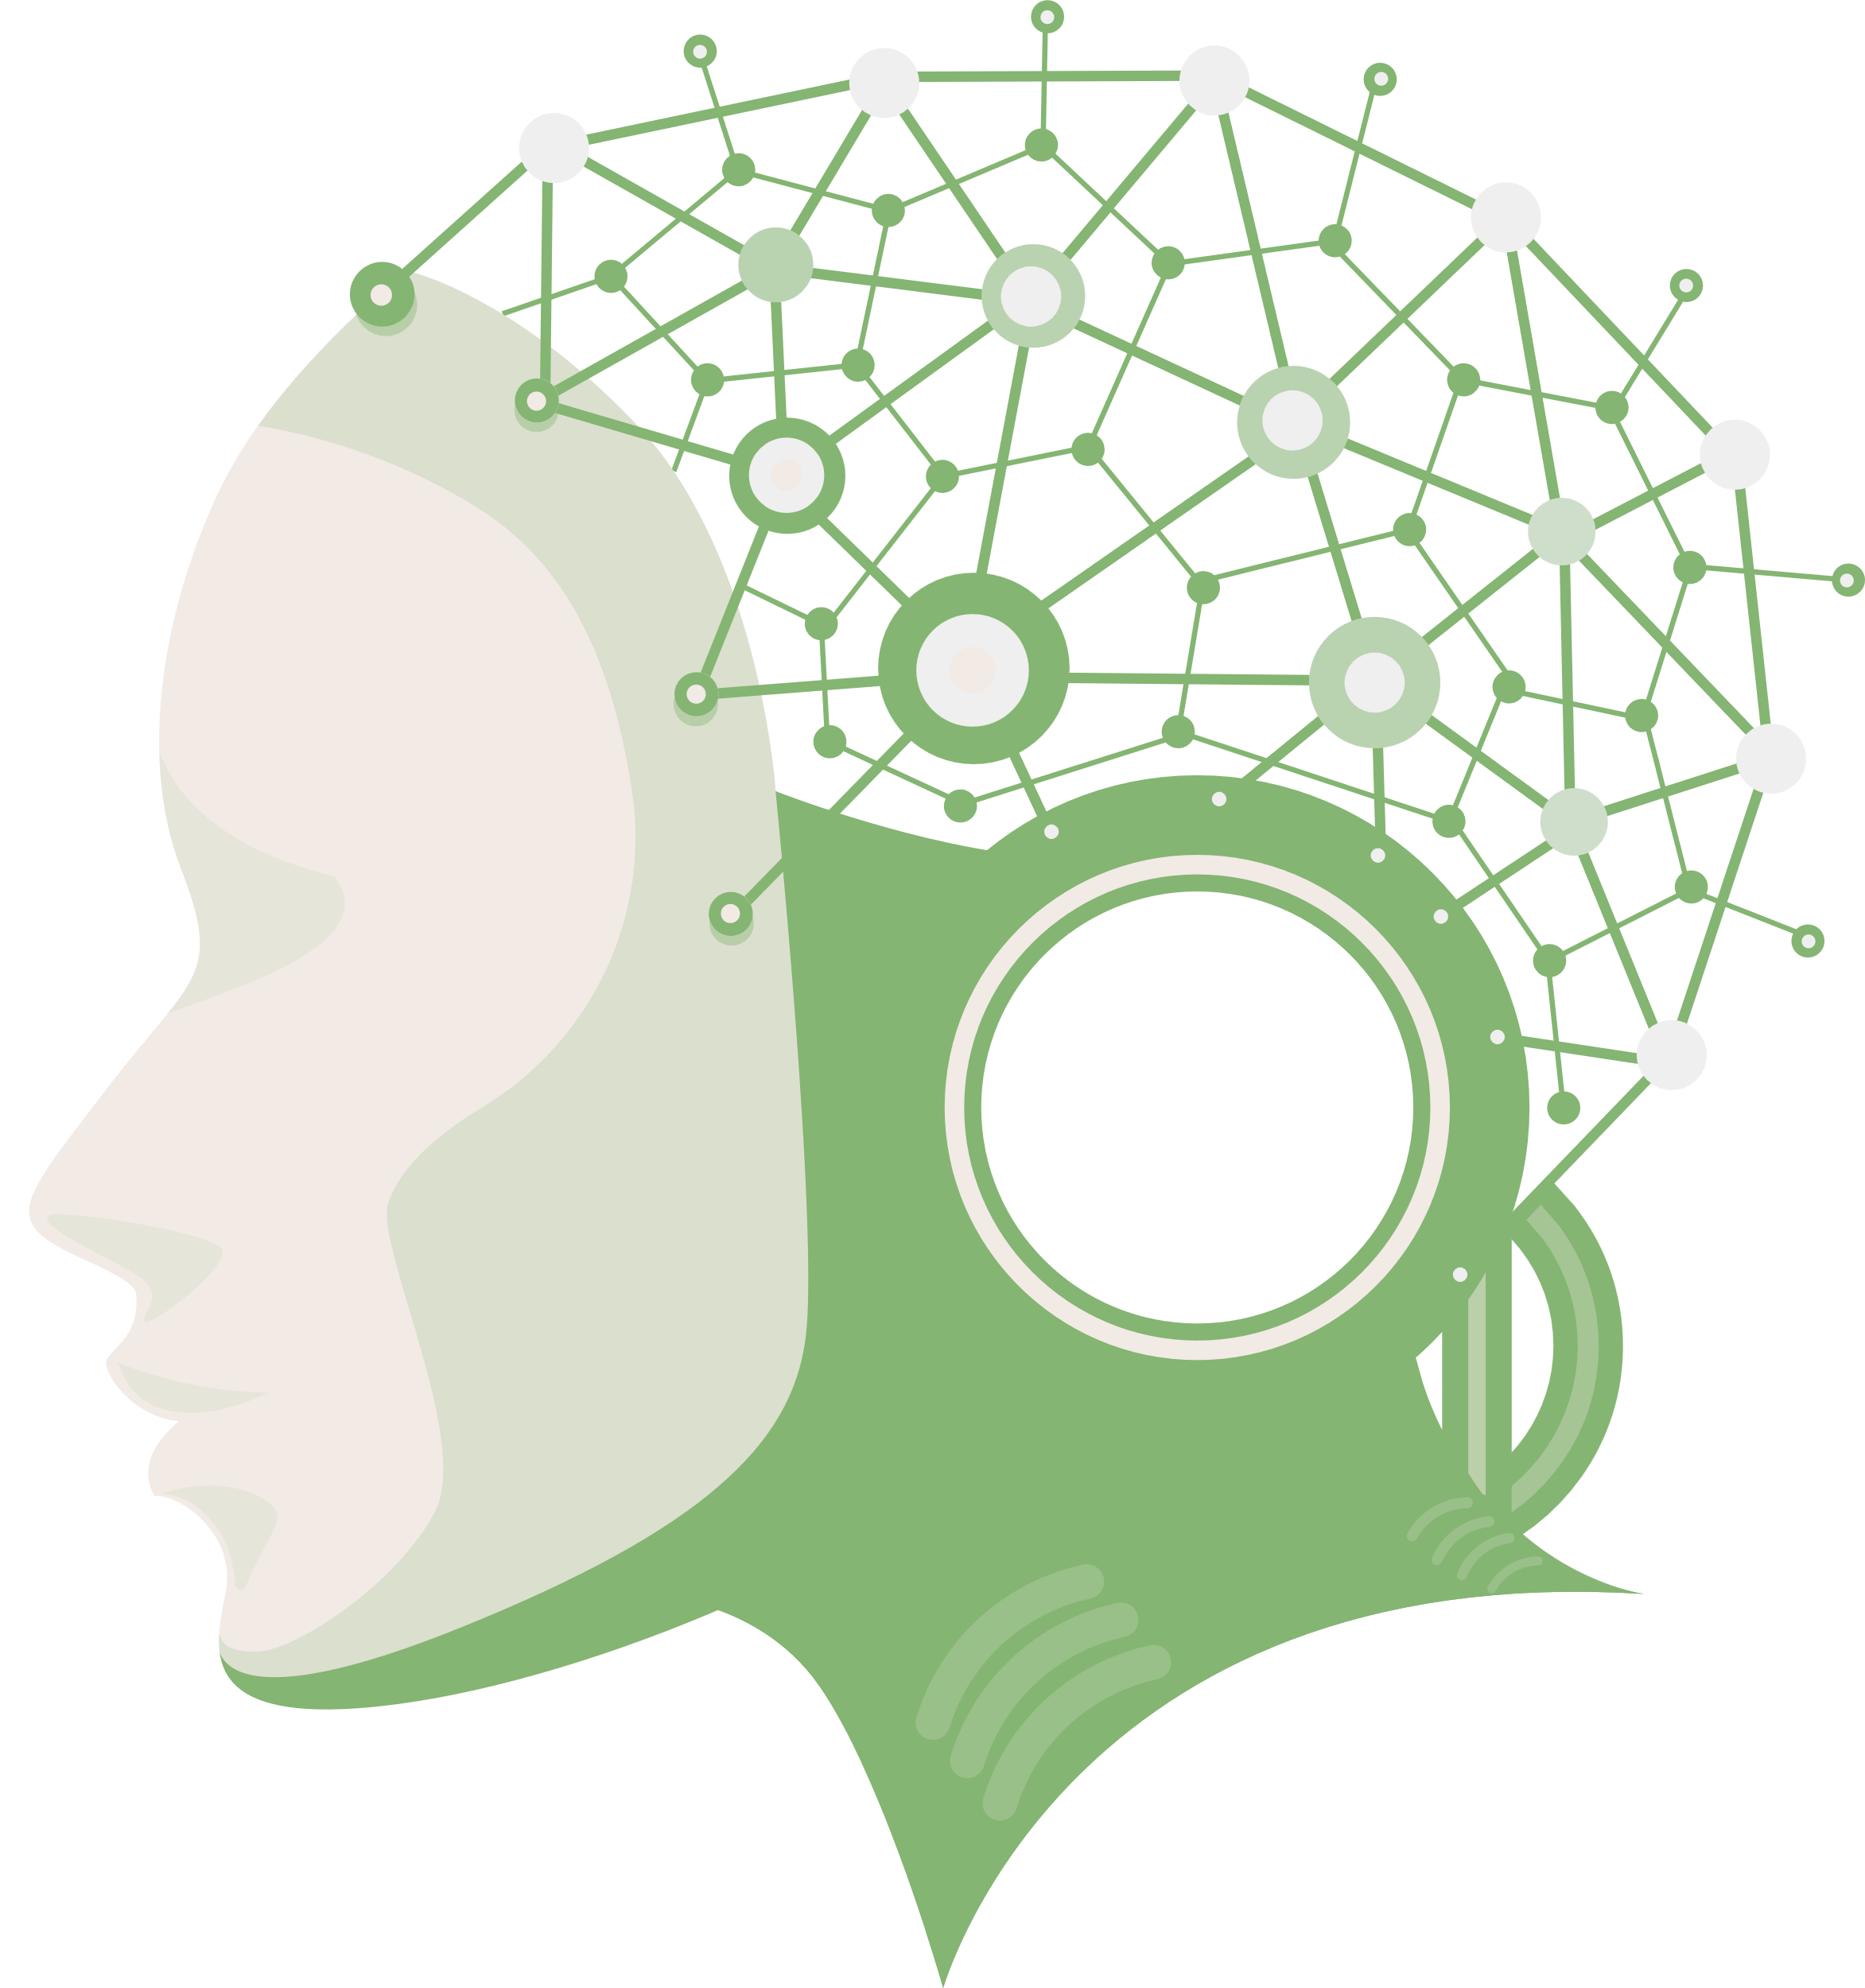
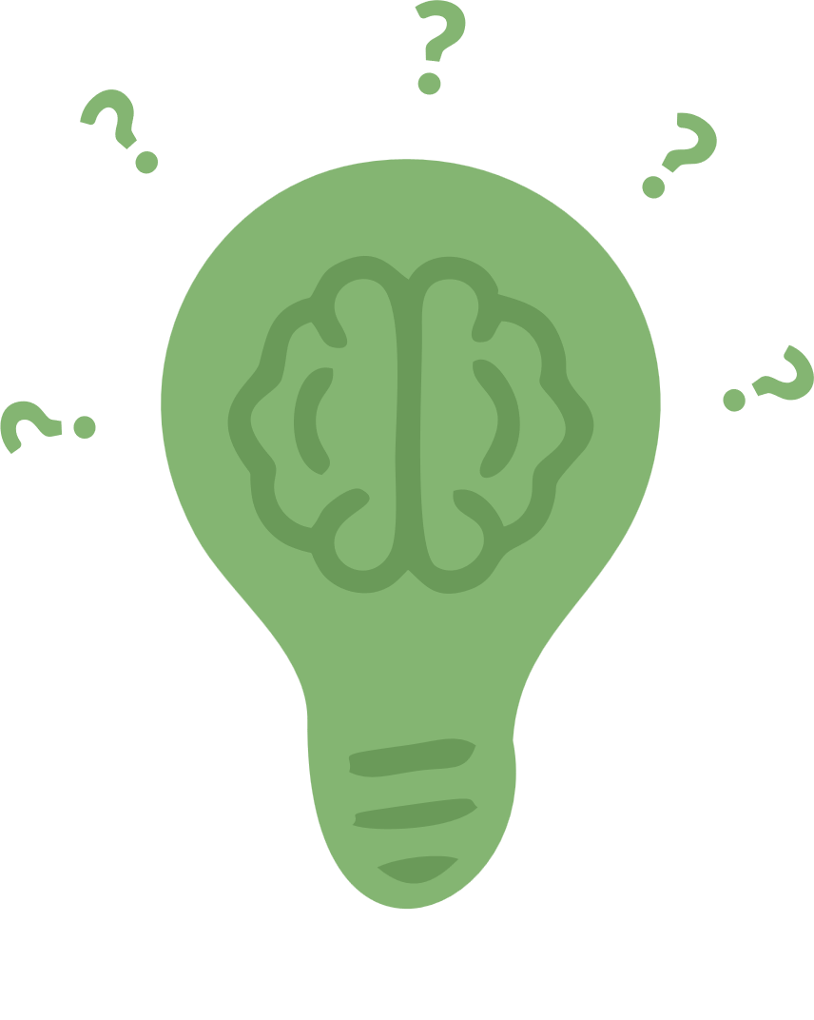

Limitations of Current Solutions
Limited Community Features
Absence of Human Interaction
Lack of Integrated AI and Community-Driven Features
Stigma and Awareness
Shezlong lacks features for peer support and story sharing.
Woebot provides 24/7 AI support but no human therapist interaction.
BetterHelp does not incorporate community features or AI-powered psychological tests.
Current solutions often do not specifically address cultural barriers and the lack of awareness prevalent in Egypt.

Slide 9

Solution
01
Mental Health Articles
02
Therapists Section (Doctor Directory)
MindFul offers a comprehensive, multi-faceted platform designed to overcome these challenges:
03
AI-Powered Psychological Testing
04
AI-Driven Chatbot
05
Positive Notifications
06
Stories Section

Slide 10

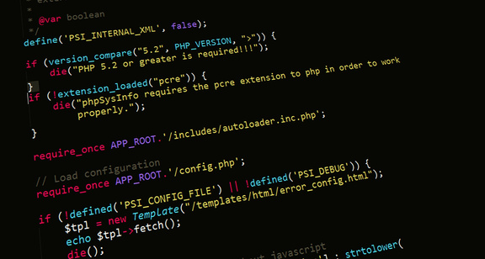

Technology
Frontend
Backend
Tools
HTML5, CSS3, JavaScript
Node.js & Express.js
Pinecone
ReactJS, Bootstrap, Fetch
MongoDB
Figma

Slide 11
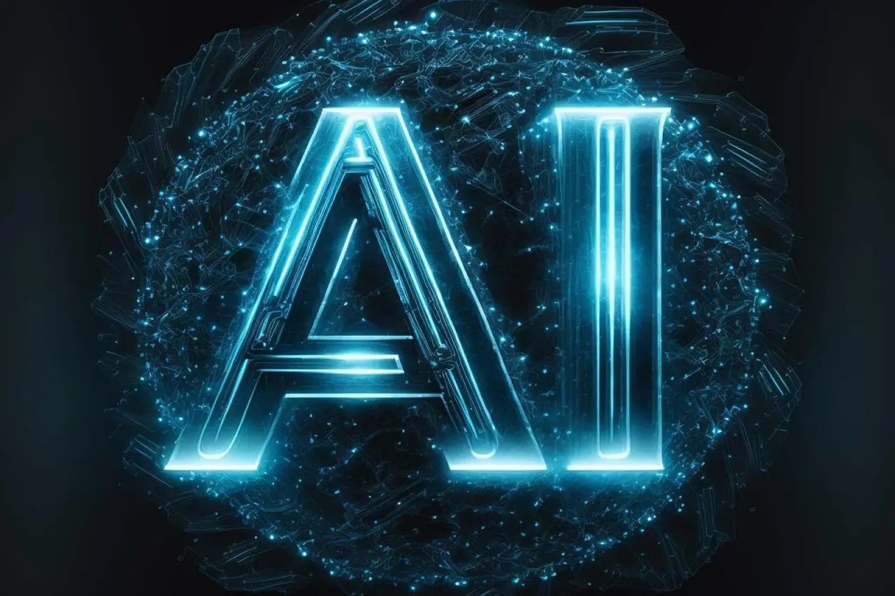
Artificial Intelligence (AI)
Based on recent research (e.g., [4], [5], [6]), we experimented with various machine learning models to ensure optimal performance.
Our approach also incorporates Retrieval-Augmented Generation (RAG), which, based on studies like [7] and [8], has proven highly effective in improving model performance, especially within medical and mental health contexts.

Slide 12

AI-Powered Psychological Tests
Panic Disorder Detection
Uses XGBoost Classifier (97.62% accuracy) on a Panic Disorder Detection Dataset.
Social Media Mental Health
Uses Logistic Regression (98% accuracy) on a Social Media and Mental Health Dataset.
Anxiety Prediction
Uses Support Vector Machine (SVM) (93.45% accuracy) on a Social Anxiety Dataset.

Slide 13

AI-Powered Chatbot with RAG
Generation Phase
Retrieval
Phase
Utilizes “sentence-transformers/all-mpnet-base-v2” embedding model and Pinecone (vector database) for similarity searches, retrieving top relevant document chunks.
Powered by MistralAI’s “Mixtral-8x7B-Instruct-v0.1”, a sparse Mixture-of-Experts (MoE) model, chosen for efficiency, performance, and open-source nature.
Built on the Mental Health Counseling Conversations Dataset (3,512 anonymized therapist-client dialogues).

Slide 14

User Management Module
Psychological Tests Module
Handles user registration, login, authentication, and account administration.
Integrates machine learning models for standardized psychological assessments.
Features
Chatbot Module
Stories Module
Provides an intelligent assistant for immediate guidance and emotional support.
A safe space for users to share experiences and provide peer support.

Slide 15
Doctor Directory Module
Articles Module
Allows licensed mental health professionals to register and provides a directory for users.
A platform for doctors to publish informative content and raise awareness.
Features
Positive Notifications
Feedback Mechanism
Delivers regular motivational messages and mental wellness tips.
Incorporates a system for users to report issues and suggest improvements.

Slide 16
Demo Video

Slide 17
Future Work
Mobile Application
Increase accessibility and engagement through a dedicated smartphone app.
The MindFul project has a strong foundation and significant potential for future enhancements and expansions to further improve mental health support:
Voice Interaction
Enable voice-based chatbot for improved accessibility.
Advanced AI Recommendations
Offer personalized content and coping strategies based on user data.

Slide 18
Future Work
Multilingual Support
Expand beyond English and Arabic to reach a global audience.
The MindFul project has a strong foundation and significant potential for future enhancements and expansions to further improve mental health support:
Therapist–Patient Communication
Add secure messaging and video consultations.
Progress Dashboard
Allow users to track mood, tests, and wellness over time.

Slide 19
Conclusion
MindFul successfully delivers a comprehensive, integrated mental health support platform.
It leverages highly accurate AI models for psychological assessments and an empathetic RAG-enhanced chatbot. By fostering a supportive community and improving access to professionals, MindFul effectively addresses mental health challenges, reduces stigma, and provides reliable, culturally relevant content, particularly for the Egyptian context.
The platform's robust architecture and user-centric design confirm its potential to significantly improve quality of life and foster healthier societies.

Slide 20
References
[1.1] BetterHelp Surpasses 5 Million People Benefiting from Online Therapy Service
[1.2] First Session Survey on BetterHelp User Experiences
[2.1] Shezlong: First Online Psychotherapy Platform in Egypt and MENA
[2.2] Shezlong Launches MENA’s First AI Therapy Assistant
[3.1] Woebot Health Study on AI’s Ability to Address Equity and Accessibility Gaps
[3.2] Randomized Controlled Trial Comparing Woebot to Clinician-Led Psychotherapy
[3.3] Study on Therapeutic Bond with Woebot
[4] Mental Health Prediction Using Machine Learning
[5] Mental Illness Prediction using Machine Learning Algorithms
[6] Predicting Anxiety, Depression, and Stress using Machine Learning Algorithms
[7] Retrieval Augmented Generation for 10 Large Language Models and its Generalizability in Assessing Medical Fitness
[8] JMIR Research on AI in Mental Health (2025)

Slide 21
Datasets
Panic Disorder Detection Dataset. Kaggle.
Social Media and Mental Health. Kaggle.
Social Anxiety Dataset. Kaggle.
Mental Health Counseling Conversations. Hugging Face.

Slide 22
Graduation Project
-
MindFul
-
Presentation 2025
Thank You

